Slide 1

Transfer 101
Presented by the
Grossmont College Transfer Center

Slide 2
Transfer Options Overview
Which University to Choose: California State Universities CSU (23 campuses), University of California campuses UC (10 campuses), California Private Universities and Out-of-State Options
What general education to follow: There are three options for transfer general education; CSU general education for all CSU campuses, IGETC general education for all CSU and UC campuses, general education for private and out-of-state campuses that is specific to the campus (available on the university's website)

Slide 3
Transfer Options Overview Continued
Major preparation for CSU and UC: students can access major preparation on www.assist.org or the university's website.
Transfer Programs: SDSU Transfer Admission Guarantee for some majors. CSU's Associate Degree for Transfer. UC Transfer Admission Guarantees. More information on university websites.
Admission information is CSU, UC or campus specific. Check the university website.

Slide 4
Local Transfer Options
SDSU is our local CSU campus. There are 23 California State University campuses.
UCSD is our local UC campus. There are 10 University of California campuses.
100+ California Private Universities. Point Loma Nazarene, University of San Diego, and National University are examples of local private universities.
Out-of-State Universities – Arizona State University is a popular destination for California students.
International Universities are also a possibility
It is a good idea to apply to more than one campus!
Notes:
Ask students where they’d like to transfer.

Slide 5

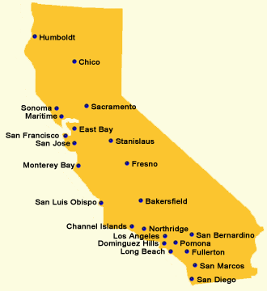
CSU System
Minimum Transfer Requirements
  Minimum of 60 CSU transferable units
  2.0 minimum GPA HOWEVER many campuses/majors require higher GPA to be competitive
  Good standing at last college/university attended
  Golden Four mandatory courses for all CSUs: Written Communication, Oral Communication, Critical Thinking, and Mathematics
  General education (CSU GE or IGETC)
Notes:
Show ADT information on Grossmont’s website (follow hyperlink). Can also demo Assist. TAG for SDSU

Slide 6
Selecting Classes (CSU)
ADT Options at Grossmont: Administration of Justice, Anthropology, Art History, Biology, Business Administration, Communication Studies, Computer Science, Early Childhood Education, Economics, English, Geography, Geology, Global Studies, History, Journalism, Kinesiology, Mathematics, Music, Philosophy, Physics, Political Science, Psychology, Sociology, Spanish, Studio Arts, Theater Arts
General Education (CSU GE or IGETC)
Major preparation
  Associate Degree for Transfer, vs.
  www.assist.org (see counselor)
Prerequisites might be needed for GE or major preparation
Electives only if you do not have 60 CSU transferable units
Which CSUs accept my ADT?

Slide 7
CSU Deadlines
Term | Application Opens
Fall | October 1
Winter | June 1
Spring | August 1
Summer | February 1
Apply using “Cal State Apply”
  Very specific deadline to apply; Oct-Nov for fall and August for spring semester.
  All campuses are open for fall semester. Only non-impacted campuses are open spring semester.
Applications are due one year in advance!
Check CSU website for specific transfer deadlines
CSU Application must be updated in January and some CSU's have supplemental applications
If your major requires an associate degree for transfer you must apply for your associate degree early, preferably in January for fall admission.
Official transcripts of all college courses must be submitted. See CSU website for deadline dates

Slide 8
SDSU Transfer Pathways
Associate Degree for Transfer Pathway
  The SDSU website lists the majors that MUST have an Associate Degree for Transfer.
  Students that apply to an ADT pathway major with an ADT will receive priority admission.
Transfer Admission Guarantee Pathway (only some majors – check SDSU website)
  Complete 100% of your transferable units from community colleges in SDSU's local admission area or complete 100% of your transferable units from Palomar or MiraCosta community colleges and apply for a program that is not offered at CSU San Marcos.
  60 transferable units
  Complete General Education—CSU GE or IGETC
  Major Preparation—Complete all major preparation courses by the end of the spring term prior to fall admission.
  Grade Point Average—Meet and maintain the cumulative GPA required for your major or 2.4, whichever is higher. Your GPA is based on all transferable units attempted.
  Prior SDSU Coursework—If applicable, maintain a 2.0 or higher GPA for any SDSU Regular Session, Special Session, Open University or Cross Enrollment coursework. This is in addition to the cumulative GPA listed above.
General Pathway –
  Students applying under the General Pathway will be considered for admission using the TAG criteria above with no guarantee of admission.
For more see our SDSU Transfer Pathways workshop

Slide 9
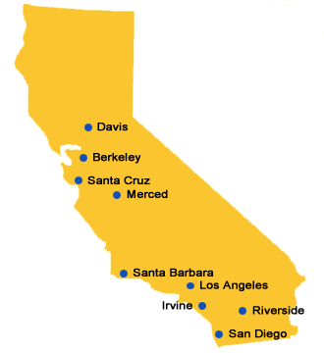
UC System
Minimum Transfer Requirements
  Minimum of 60 UC transferable units
  2.4 minimum GPA (2.8 for nonresidents) though admission is competitive, and GPA will be higher
  7 Course Pattern; Two transferable English requirement, one transferable mathematics courses and four other general education courses

Slide 10
Selecting Classes For UC
Select General Education courses (IGETC)
  Or 7 Course Pattern
Select Major Preparation courses. Go to www.assist.org or see if your major has a UC Transfer Pathway. See counselor for assistance.
Some of the general education and major preparation require prerequisite courses. Take these first.
Electives (only if you have less than 60 UC transferable units).

Slide 11
Paying for UC
Make sure you apply for financial aid before the deadline. Go to fafsa.gov
Blue and Gold Opportunity Plan!!!
  What’s Covered:
    If eligible, systemwide tuition and fees will be fully covered by scholarship or grant money. The plan combines all sources of scholarship and grant awards received (federal, state, UC and private) to go toward covering your tuition and fees.
    Students with greater financial need can qualify for even more grant support to help defray other educational expenses (books, housing, transportation, etc.)
  Website: https://admission.universityofcalifornia.edu/tuition-financial-aid/types-of-aid/blue-and-gold-opportunity-plan.html

Slide 12
UC Transfer Pathways: Major Preparation Roadmap to UC's most Popular majors
Anthropology
Biochemistry
Biology
Business Administration
Cell Biology
Chemistry
Communication
Computer Science
Economics
Electrical Engineering
English
History
Mathematics
Mechanical Engineering
Molecular Biology
Philosophy
Physics
Political Science
Psychology
Sociology
Go to www.universityofcalifornia.edu

Slide 13
UC Transfer Admission Guarantee (TAG)
Eligibility requirement link
Campuses:
Davis
Irvine
Merced
Riverside
Santa Barbara
Santa Cruz
For more information, go to the university's website!
Fall Application deadline
Sept 30!
UC Pathways+ = Transfer Pathway and TAG requirements

Slide 14
UCSD University Link
UCSD Admission Program Highlights:
  Guarantee for first time college students, veterans, and foster youth
  $40,000 income cap for first time students
  3.5 minimum GPA required
  Website: https://admissions.ucsd.edu/transfer/universitylink.html
Application deadline
End of 1st year!

Slide 15
UC Deadlines
Check admission.universityofcalifornia.edu for
  Transfer admission requirements
  Application timeline, etc.
  To apply, go to www.universityofcalifornia/apply
Applications are due one year in advance!
  TAG Sept. 1-30
  Fall Application opens Aug. 1
  Submission period Nov. 1-30
  Application Update Jan 31
  Official Transcripts will be required of all college courses. Check university website for deadlines.

Slide 16
UC TAP
Transfer Admission Planner allows you to keep track of your UC progress toward transfer.
  Connects to TAG!
  And to your UC Application!
  Receive updates from UC throughout time at Grossmont!
  A way to stay updated on events taking place at Grossmont related to your preferred campus(es)!
  Go www.universityofcalifornia.edu for more information

Slide 17
Private & Out-of-State Schools
Requirements vary by school
Consult the school’s website and catalog for transfer admission and major information
Check with school regarding minimum/maximum units accepted as a transfer
Grossmont has articulation agreements with a number of schools
IGETC and CSU GE are accepted by some private and out-of-state schools

Slide 18


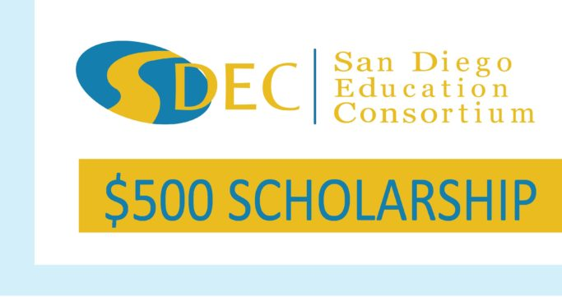













San Diego Education Consortium
More info coming soon… check back with Transfer Center

Slide 19
What you must know to set a transfer deadline
The specific university you want to attend
The general education and major preparation you have completed and will need to take
Total transferable units needed to transfer
Transferable GPA required for admission to the university and major
Application deadline for the institution you want to attend
MEET WITH A COUNSELOR to develop a comprehensive education plan for your specific goal.

Slide 20
Did You Know…
PLNU offers Adult Completion Programs at local community college campuses for approx. half the cost of one year of tuition at the main campus and it includes the cost of books! (@Grossmont: Computer Info Technology & Nursing)
National University offers a scholarship to students who have earned an Associate degree bringing cost of tuition to $7000 per year for two years!
Arizona State University offers guaranteed admission to California Community College students who meet eligibility requirements!
You have access to guaranteed admission at 39 HBCUs!
And more opportunities exist…

Slide 21
Your Next Steps
Explore your options
  Fall/Spring Transfer Fairs: check out our Events website
  Check upcoming info sessions and rep visits
Develop an Education Plan with your Counselor
Add application periods to your calendar
Understand how to calculate your GPA
  All transferable courses are applicable
    Check www.assist.org or college catalog for transferability
  Do not include W, I, P, NP
  GPA calculator available on Transfer Center website!

Slide 22

Get answers by meeting with a counselor soon!
Remember we are here to help!

