Slide 1
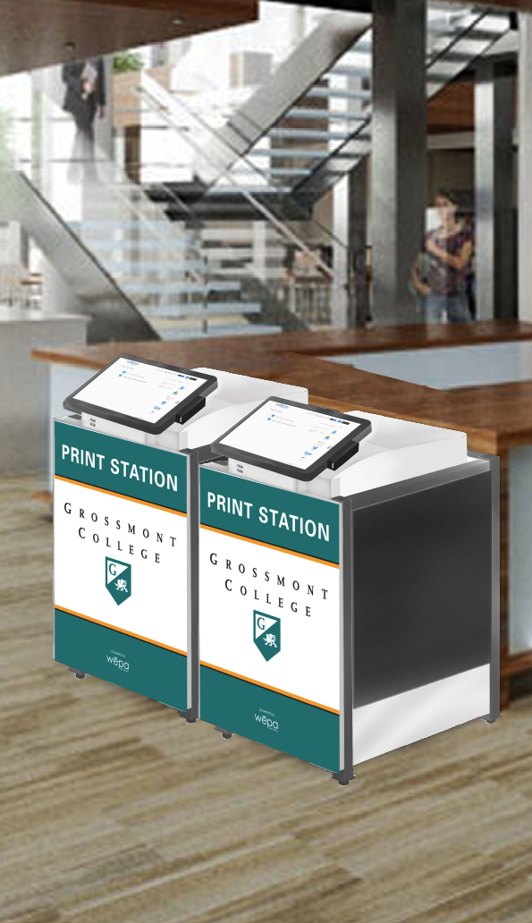
PAY PRINTING
GROSSMONT COLLEGE

Slide 2
CURRENT
CopyVend
11
(5) Techmall
(3) Library
(1) 60-145 (Career)
(1) 30-252 (Chemistry)
(1) 34-254 (Health)
Server (VM)
Server Support
Station PC/Monitor
Usage
Cash Only
Support
Print to assigned printer from lab computer
Choose Job from public list at Kiosk
.15¢ BW / .75¢ Color
Accepts $1 and Coins
Server (VM)
Station PC/Monitor
Ink/Paper
Notify Support
Refunds
Specialized imaging
Our
Goals

Slide 3
PROPOSED
WEPA
7
(3) Techmall
(2) Library
(1) 60 (Commons)
(1) 30 (Commons)
License
Paper
Fixed Print Cost
Usage
Card/Cloud
Support
Print to any printer from personal device, kiosk or lab computer
Login and release job from any kiosk
.10¢ BW / .35¢ Color
Credit, Paypal or Account
Option to accept Cash at Circulation
.40¢ Charge Credit @ Kiosk
Ink/Paper
Notify Support
Our
Goals

Slide 4
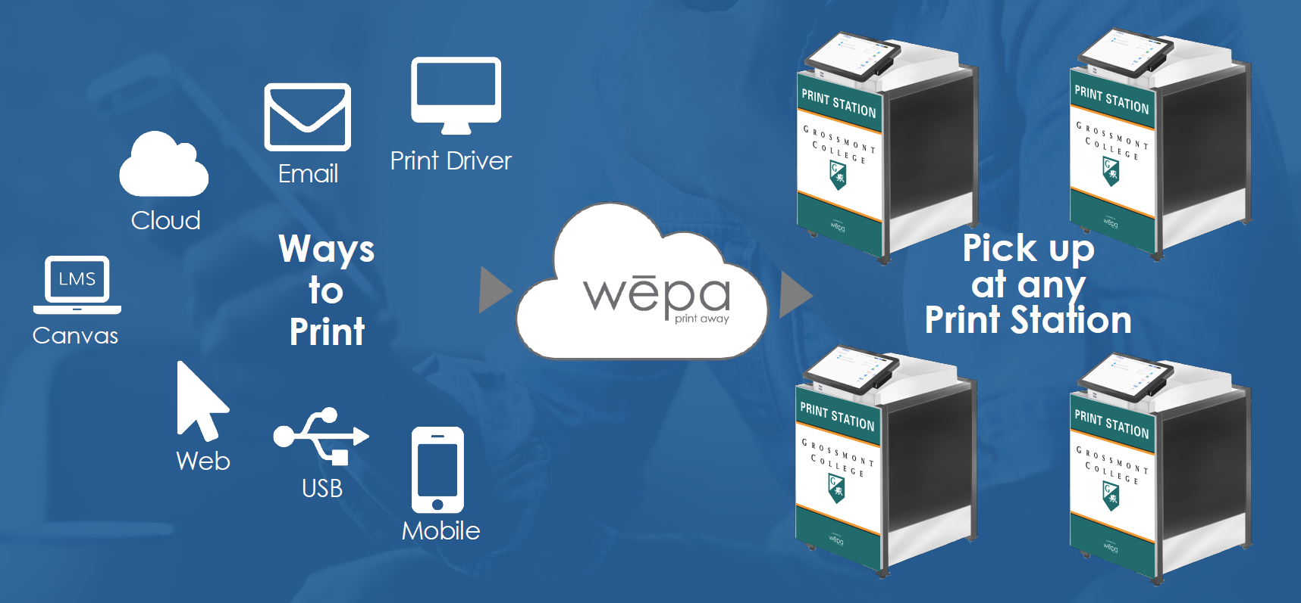
WEPA
3rd Party Cloud Based Printing with Modern Amenities

Slide 7
36 Month
Lease
$200 / Kiosk / Month
Cost .05¢ BW / .25¢ Color
Grossmont retains the difference
NOTE:
.40¢ Charge Credit @ Kiosk
$5 Minimum
EXISTING
ADD FUNDS
EARNING
STUDENT ID
APP & KIOSK
POTENTIAL

Slide 8
EXAMPLE
YIELD / PRINTER
34-254: 6,568 *.05 = $328
30-252: 10,934 * .05 = $547
60-145: 1,517 *.05 = $76
70-151: 143,261*.05 + 1026 *.10 = $7266
70-142: 207,788 *.05 + 3400 * .10 = $10,729
2019: 370,068 BW and 4,426 Color annually
COSTS
License: (7) WEPA kiosks x $200.00 x 12 = $16,800
Paper: .0066¢ page * 374,494 = $2,397
EARNINGS
(.05¢ x 370,068) + (.10¢ * 4,426) = $18,946
Net Expense/Earning: $-251 ($18,946 – ($16,800 +$2,397))

Slide 9
SOLUTIONS
& their associated problems
Cash & Fees Circulation or Pre-pay Cards
Acclimating Students WEPA provided & Web
Low Yield Common Areas
Convenience Printing
Non-WEPA Print management
Declining Use

Slide 10
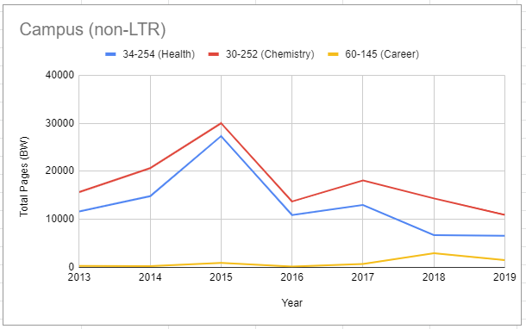
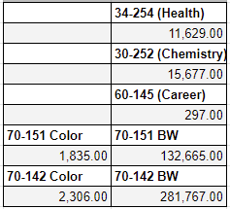
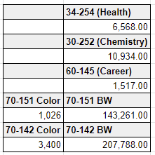
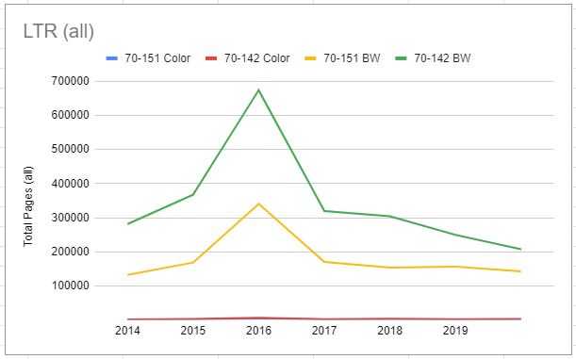
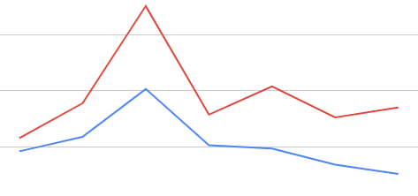
2013
2019
18% Decrease Overall
Building 70: 63,098 pages ($3,155/yr @.05 ¢)

Slide 11
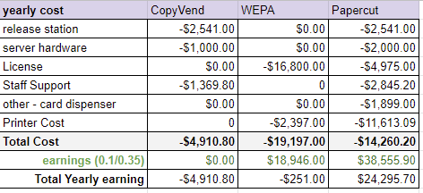
COST COMPARISON
COPYVEND, WEPA, PAPERCUT
Our
Goals

