Slide 1
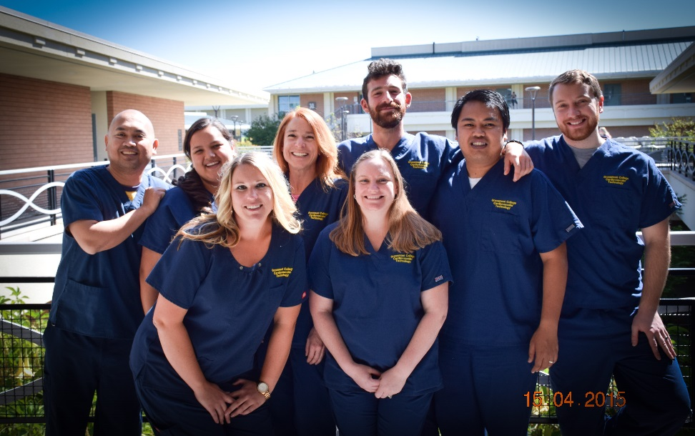
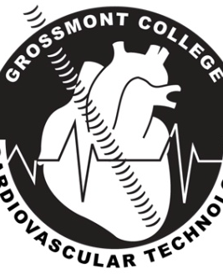
Cardiovascular Technology Program Preview
Liz Barrow, BA, RCIS, CEPS
Program Director

Slide 2

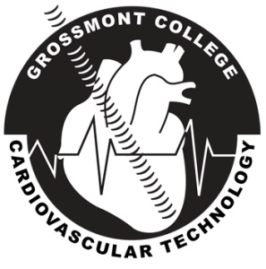

Grossmont College CVT Program
48 years old – Since 1972
First accredited CVT program in the country
CAAHEP (Commission on Accreditation of Allied Health Education Programs) www.caahep.org

Slide 3
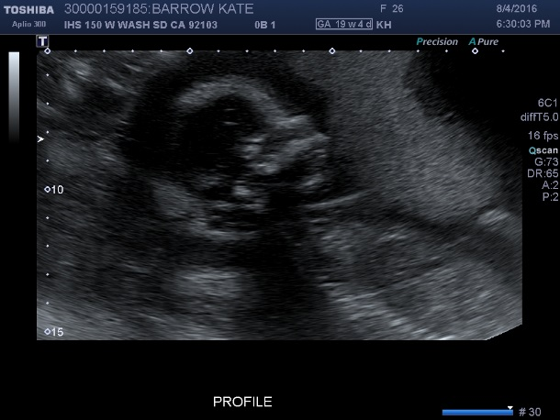
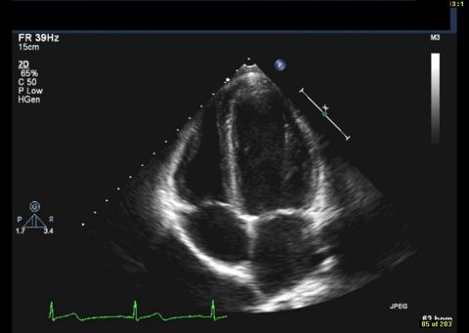
Ultrasound Programs
In CA: DMS Cardiac US – 3, Vascular US – 2
In CA: CVT Cardiac US – 2, Vascular US – 1, Invasive - 1
DMS – Diagnostic Medical Sonography
CVT – Cardiovascular Technology
General Ultrasound*
All the “guts”
OB/GYN
*NOT offered at Grossmont
Adult Echocardiography
Pediatric Echocardiography*
*Not offered at Grossmont
Vascular Technology
*Posted with permission from Kate Barrow

Slide 4
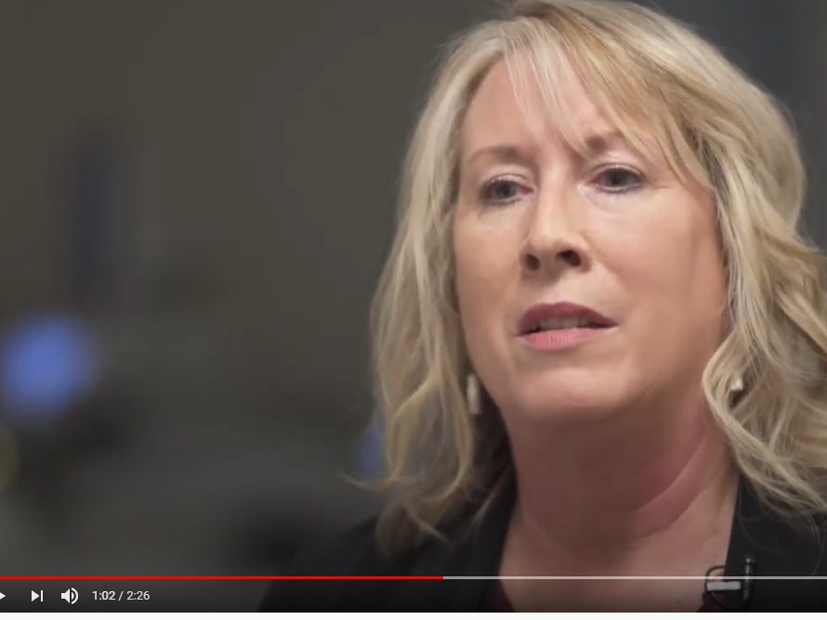
Cardiovascular Technology Program Video
California Community College – Workforce video series:
https://youtu.be/dFoTiqVZcLo

Slide 5
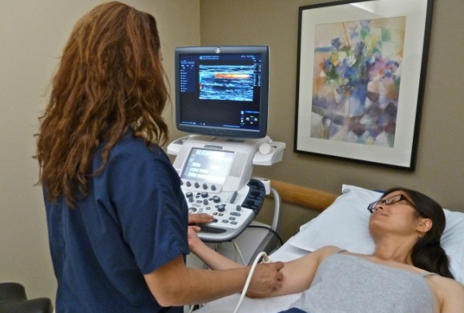
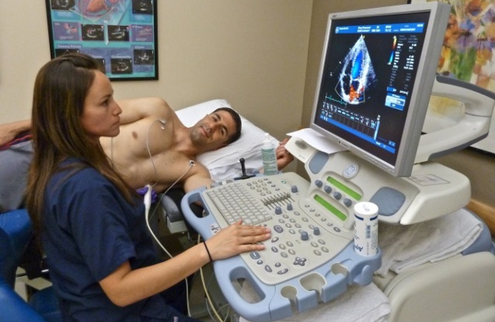
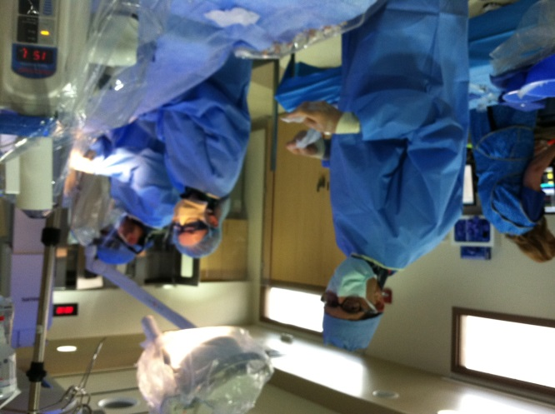
Grossmont College We have 3 CVT Track Specialties
Vascular Technology (Ultrasound)
Adult Echocardiography (Ultrasound)
Invasive Cardiovascular Technology (Cath Lab)

Slide 6
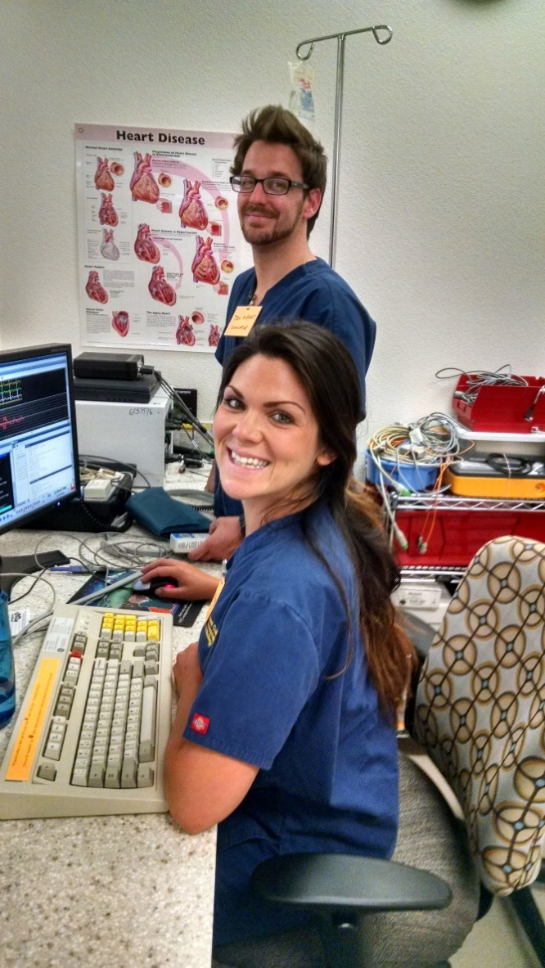
Invasive CVT
Cardiac Catheterization Lab
Radiology Suite
Work as a team member
Roles are Scrub, Monitor, Circulate
Procedures include Heart Catheterization, Pacemaker Implants, Peripheral Intervention
Video of normal coronary angiogram.

Slide 7
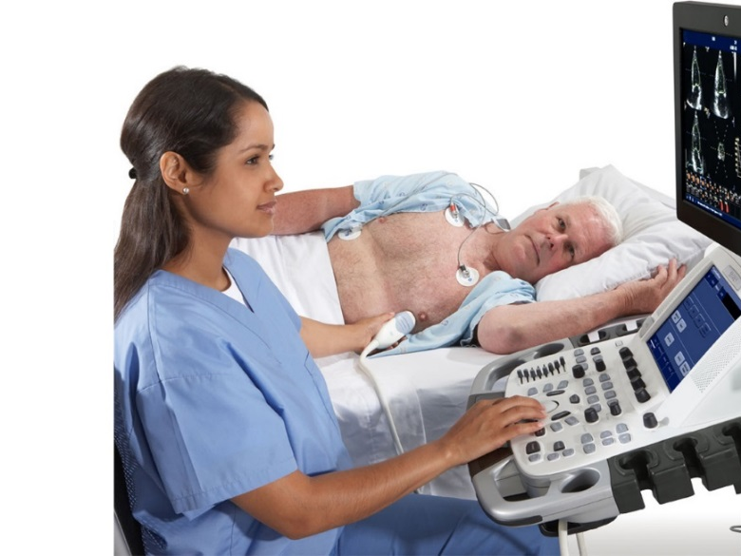
Echo Tech
Echo Lab, Hospital or Clinic setting
One on One with the patient
Ultrasound of the heart
Video of echocardiogram
Brief explanation of echocardiogram

Slide 8
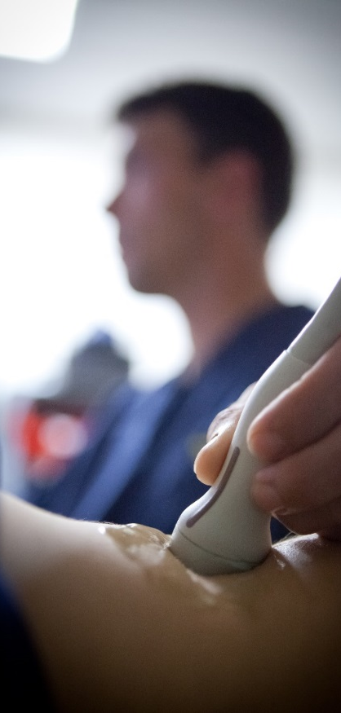
Vascular Tech
Vascular Lab, Hospital or Clinic setting
Cardiology
Neurology
Vascular Surgery
Radiology
One on One with the patient
Ultrasound of all arteries and veins
Video of carotid artery study

Slide 9
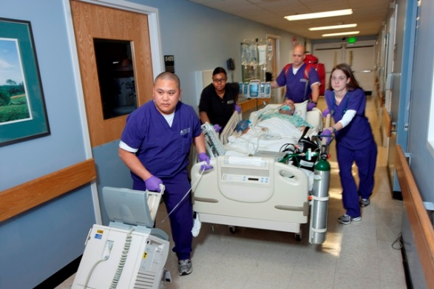
Physical Requirements and Essential Functions
Communication Skills
Critical Thinking and Problem Solving
Social Skills
Observation and Sensory Skills
Lifting
Pushing
Pulling
Reaching
Standing
Walking
Hand manipulation
Visual and Auditory

Slide 10
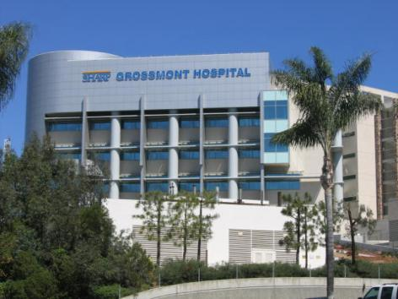
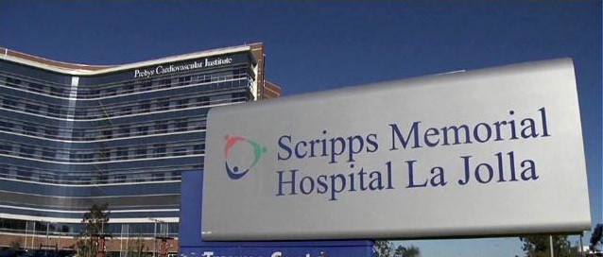
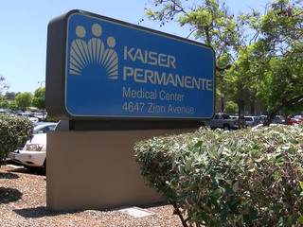
CVT Program
2000+ graduates
Instructors are graduates
Local clinical sites

Slide 11


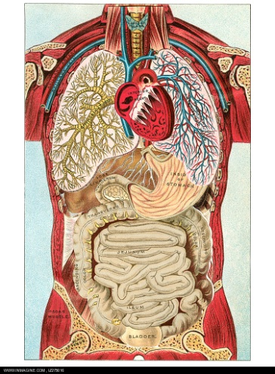

Prerequisites
High School Graduate (or higher degree)
Chemistry 115 (or equivalent)
Anatomy & Physiology
Biology 144/145 OR
Biology 140/141/141L
(or equivalent)
7-year recency rule

Slide 12
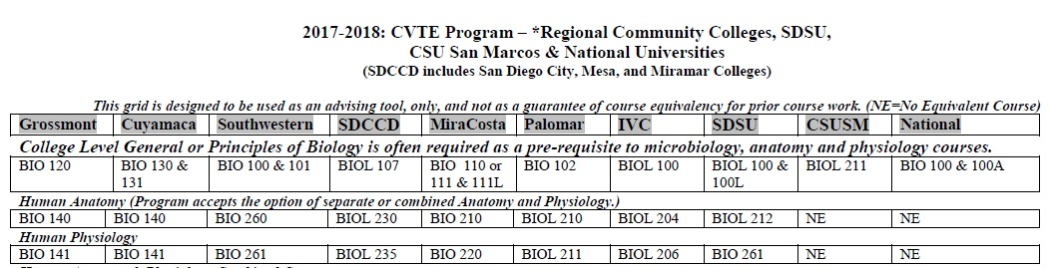
Equivalency Grid
Click to see full equivalency chart

Slide 13
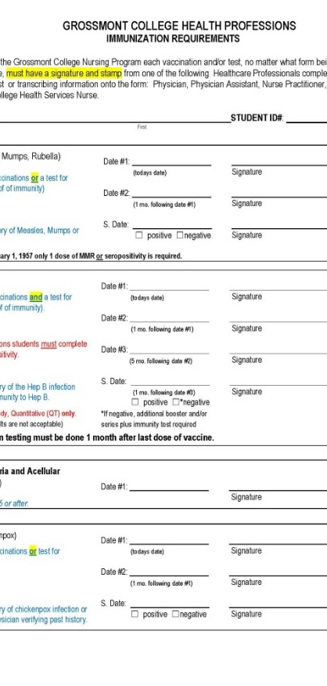
A Completed Application
Application form
(found on website)
Proof of HS diploma
Immunizations
(form on website)
Official transcripts of prerequisites
Note: due to COVID transcripts will be accepted once campus is opened.
Course descriptions if not from local colleges

Slide 14
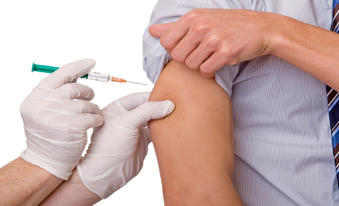
Student Health Services
East Region Public Health
367 N Magnolia Ave
Suite 101
El Cajon, CA
Phone: (619) 441-6500
Grossmont College
Monday - Thursday:
9am-5pm
Friday:
9am-1pm
Located in Bldg 60-130
619-644-7192
Health Services Website

Slide 15

Application to Program
Open application period
Completed Application date/time stamped
Waitlist (on average 2 years)

Slide 16
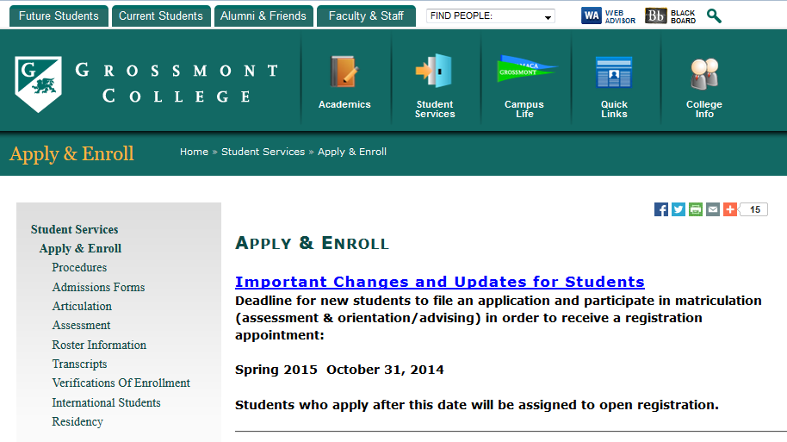
Applying to College
*Must enroll if you have not had classes in last two semesters

Slide 17

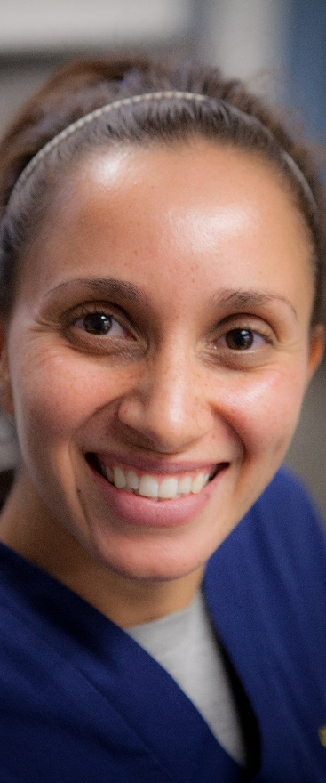
Seating a CVT Class
Seat a new class of students each fall semester
February/March applicants on waitlist are contacted and invited
March class is seated
May Orientation
Student Packet due in July
Program begins in August

Slide 18

General Ed 24-26 Units
Area A – Language and Rationality (9 units)
Area B – Natural Sciences (7 units)
Area C – Humanities (3 units)
Area D – Social Sciences (3 units)
Area E – Fitness/Wellness (2 courses, 1-2 units each)

Slide 19
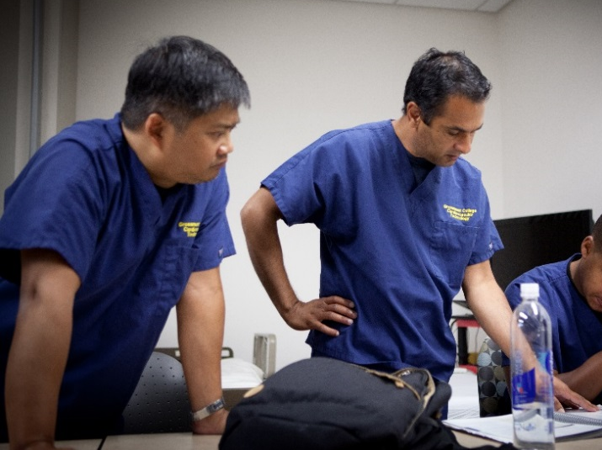
CVT Courses – Core Curriculum
Fall – First Year
CVTE 100
Physical Principles of Medicine I
CVTE 101
Cardiovascular Physiology I
CVTE 102
Medical Instrumentation
CVTE 103
Laboratory Practicum and Proficiency Testing
CVTE 107 (optional)
Introduction to Clinical Practicum I
Link to College Catalog and course descriptions

Slide 20
Advice from Grads
“Be prepared to make this your first, second and third priority in your life for the next 2 years. It takes a lot of time from your social life, but it is worth it. If you’re not willing to commit to the study load and clinical rotations, you won’t get what you need from this program, and ultimately you’d be wasting your time if you don’t commit to the program.”
“Read the book. Record lectures.”
“I had a great experience in the CVT program. I can’t express how happy I am to be working in a career I worked so hard for. As long as you put in the effort to match the effort professors and clinical instructors you will graduate and have a fantastic career.”
“I recommend reviewing each track before making a decision.”

Slide 21
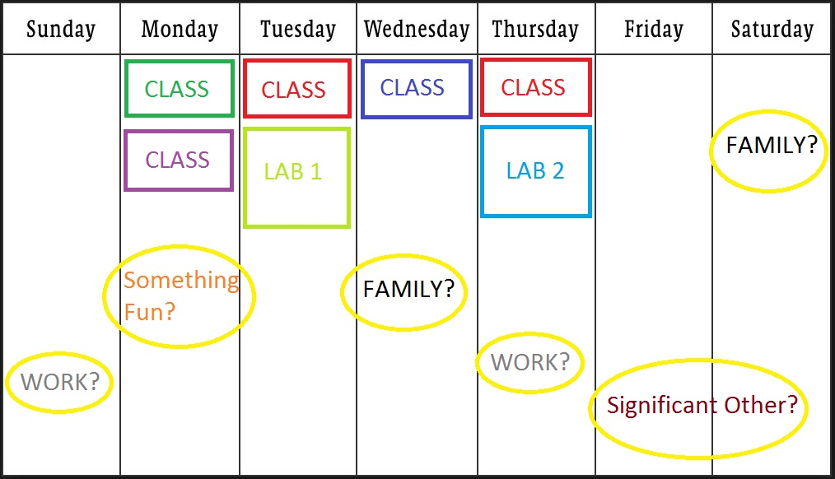
Rigorous Program!

Slide 22
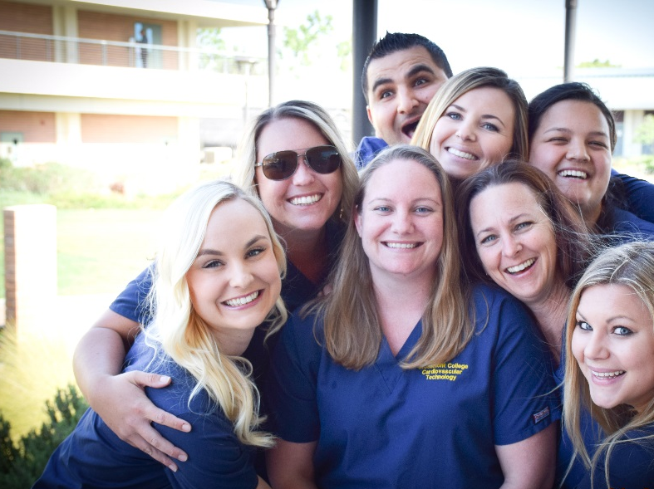
Track Selection
GPA taken from Core Curriculum (CVTE 100, 101, 102, 103).
Ranked highest to lowest.
Each student indicates track preference.
Sorted by GPA.

Slide 23
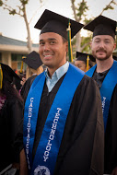
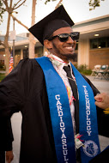
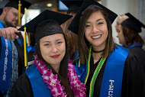
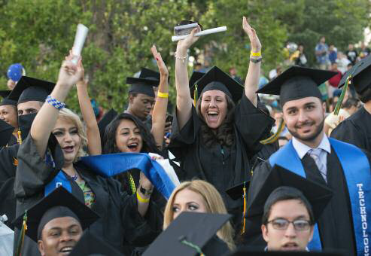
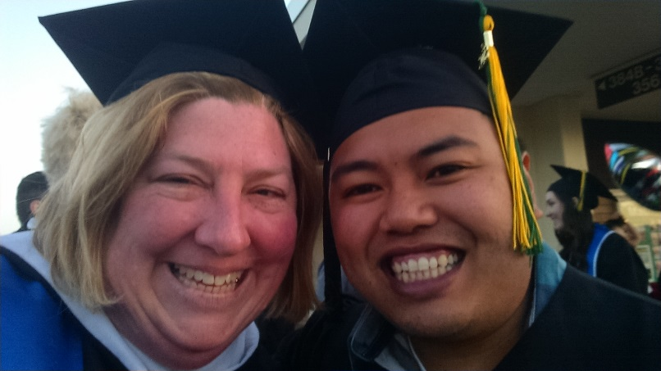
AS Degree in CVT

Slide 24
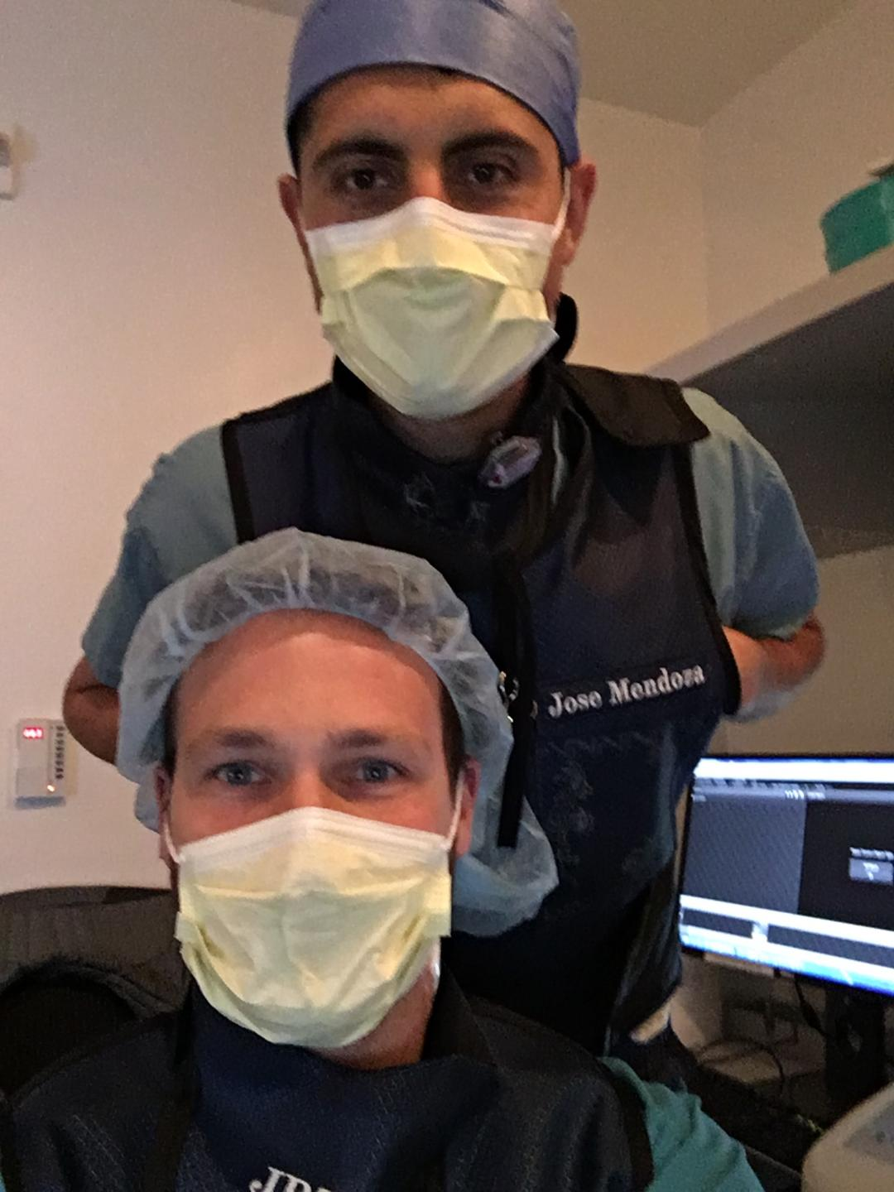

Money
Overall cost of program $5000
Tuition, books, uniforms, immunizations, malpractice insurance, background check, etc.
Median Salary: $69 – $75,000
www.salary.com

Slide 25

Financial Aid
www.grossmont.edu/fa
Scholarships
Unit limit – might want to postpone use of FA?
FAFSA – Free Application for Federal Student Aid
Early completion
Select Grossmont College

Slide 26
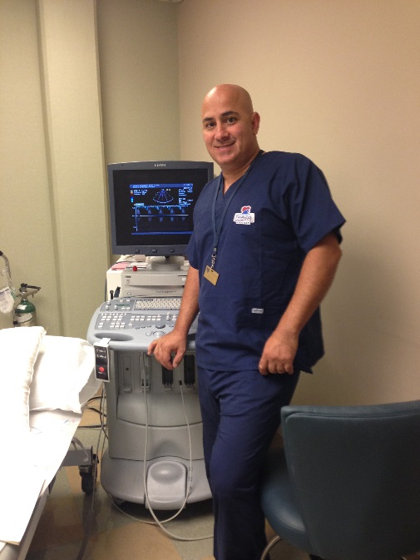
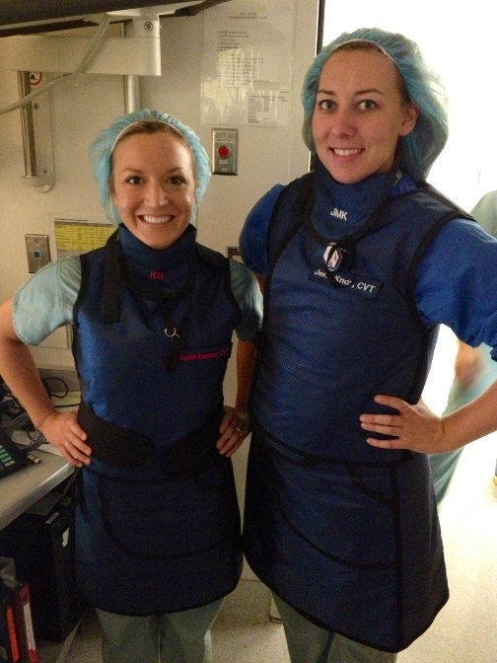
Program Outcomes: Job Placement
Class of | Echo | Invasive | Vascular
2019 | 12/13 | 12/12 | 5/7
2018 | 12/14 | 7/8 | 10/13
2017 | 8/11 | 8/10 | 4/6
2016 | 12/13 | 10/13 | 9/10

Slide 27


Program Outcomes: Registry Pass Rates
Class of | Echo (RDCS) | Invasive (RCIS) | Vascular (RVT)
2019 | 11/13 | 11/12 | 7/7
2018 | 11/12 | 3/4 | 12/13
2017 | 11/11 | 5/5 | 6/6
2016 | 13/13 | 5/5 | 10/10

Slide 28

Background Check
Necessary for clinical placement
Registry Exams
www.ardms.org
www.cci-online.org
Future Employers
Expunging your record

Slide 29
Information
Liz.barrow@gcccd.edu
Denise.Gilbert@gcccd.edu
www.grossmont.edu/cvt
www.ardms.org
www.cci-online.org
http://www.youtube.com/watch?v=W-SJxeMInDM
When searching use keywords: angioplasty, angiography, echocardiography, ultrasound, carotid arterial scan, cardiac sonography, vascular sonography

